Slide 1


Giuliano Agustín Fischetto
3/9/2023

Slide 2

Outline
Executive Summary
Introduction
Methodology
Results
Conclusion
Appendix

Slide 3
Executive Summary
Summary of methodologies
Data collection encompassed RESTful API integration and web scraping, followed by data conversion into a structured dataframe for manipulation. Exploratory Data Analysis (EDA) was conducted using SQL, Pandas, and Matplotlib, providing initial insights into trends and patterns. Visual dashboards were created through Folium and Plotly Dash, enhancing data comprehension. Machine learning techniques were utilized for predictive modeling, enabling future launch predictions.
Summary of all results
This analysis of SpaceX launches from 2010 to 2020 reveals significant trends. Success rates surged between 2013 and 2017, reflecting enhanced reliability. Among launch sites, Kennedy Space Center LC-39A boasted the highest success rate (75%) over 13 launches. Falcon 9 Full Thrust proved the most reliable booster (62% success). Surprisingly, payload mass showed minimal correlation with launch success. These insights underscore SpaceX's evolution, site performance variations, and the nuanced factors influencing mission outcomes.

Slide 4
Introduction
Project background and context
SpaceX's Achievements:
Notable milestones in space exploration.
Historic spacecraft recovery from low-earth orbit (Dec 2010).
Cost Efficiency:
Falcon 9 launches cost $62 million (SpaceX) vs. $165 million (others).
Key: Reusability of the first rocket stage.
Problems you want to find answers
Can we predict the success of the first stage landing in SpaceX launches?
Understanding the factors affecting landing outcomes.

Slide 5

Section 1

Slide 6
Methodology
Executive Summary
Data collection methodology:
API and webscraping
Perform data wrangling
Treating missing values
Perform exploratory data analysis (EDA) using visualization and SQL
Perform interactive visual analytics using Folium and Plotly Dash
Perform predictive analysis using classification models

Slide 7
Data Collection – SpaceX API
Define URL
Apply a requests.get() to the URL
The API response is decoded with the function .json()
We turn the result into a Pandas dataframe with .json_normalize()
On the right, the process for the data collection with SpaceX REST calls
DS-IBM-Course/SpaceX_DataCollection.ipynb at main · fischett/DS-IBM-Course (github.com)
Filter dataframe and give special format to datetimes
Define global variables for the final dataframe’s columns
Scrape the dataframe with requests.get()
Append the responses to the appropriate variables
Construct the final dataset (type: dict) with the global variables
Convert dataset into a Pandas dataframe
Filter for only Falcon 9 launches

Slide 8
Data Collection - Scraping
Web Scraping with BeautifulSoup
DS-IBM-Course/SpaceX_Webscraping.ipynb at main · fischett/DS-IBM-Course (github.com)
Define functions to return data from table cells
Define URL and apply .get(). Then get the HTML content with .content
Create a BeautifulSoup object
Get a list of tables with .find_all(‘table’)
From the desired table get the column names with .find_all(‘th’) by iteration
With this list, create a dict with dict.fromkeys(list), and empty the contents
Iterate for each row and use the created functions in point 1 to fill the values in the previous dict
Turn the dict into a Pandas dataframe

Slide 9
Data Wrangling
Prepare data into training Labels for the successfulness of landings
From the column ‘Outcome’, get the value_counts()
Iterate with enumerate() to get the different .keys()
Create a set() with the respective ‘bad’ outcomes .keys()
Create a binary list ‘Class’ (of 1s and 0s) for ‘good’ and ‘bad’ outcomes by iterating the dataframe and comparing its values of the column ‘Outcome’ to the last created set() of .keys()
Add the new ‘Class’ list to the dataframe
DS-IBM-Course/SpaceX_DataWrangling.ipynb at main · fischett/DS-IBM-Course (github.com)

Slide 10
EDA with Data Visualization
In order to understand the impact of each variable, we plotted various plots:
Payload Mass vs Flight Number (scatter)
Launch Site vs Flight Number (scatter)
Launch Site vs Payload Mass (scatter)
Class vs Orbit (bar)
Orbit vs Flight Number (scatter)
Orbit vs Payload Mass (scatter)
Yearly aggregated Class vs Year (scatter)
DS-IBM-Course/SpaceX_DataVisualization.ipynb at main · fischett/DS-IBM-Course (github.com)

Slide 11
EDA with SQL
With SELECT DISTINCT get the unique Launch_Site values
Show 5 rows WHERE Launch_Site LIKE 'CCA%‘
Show SUM(PAYLOAD_MASS__KG_) WHERE Customer = 'NASA (CRS)‘
Show AVG(PAYLOAD_MASS__KG_) WHERE Booster_Version = 'F9 v1.1‘
Show MIN(Date) WHERE Landing_Outcome = 'Success‘
DISTINCT Booster_Version WHERE Landing_Outcome = 'Success (drone ship)' AND PAYLOAD_MASS__KG_ > 4000 AND PAYLOAD_MASS__KG_ < 6000
Show DISTINCT Mission_Outcome
Show Booster_Version WHERE PAYLOAD_MASS__KG_ = (SELECT MAX(PAYLOAD_MASS__KG_) FROM SPACEXTABLE)
Show Booster_Version, Launch_Site WHERE SUBSTR(Date, 1, 4) = '2015‘ AND SUBSTR(Landing_Outcome, 1) = 'Failure (drone ship)‘. Use CASE function to map and express results with Month
Show Landing_Outcome, COUNT(*) AS OutcomeCount, WHERE Date >= '2010-06-04' AND Date <= '2017-03-20‘, GROUP BY Landing_Outcome, ORDER BY OutcomeCount DESC
DS-IBM-Course/Spacex_SQL.ipynb at main · fischett/DS-IBM-Course (github.com)

Slide 12
Build an Interactive Map with Folium
Circles added with respective Markers:
NASA Johnson Space Center
Launch Sites:
KSC LC-39A
CCAFS SLC-40
CCAFS LC-40
VAFB SLC-4E
MarkersCluster added: to each Launch Site we added a cluster of folium.Icon() with red or green colors for failed or successful launches
Lines added and respective markers to trace the distance between KSC LC-39A and different locations like closest railway, coastline, city, roadway.
This was done for the statistical understanding on the successfulness of launches for each launch site, and to see the location properties of these sites
DS-IBM-Course/SpaceX_SiteLocation.ipynb at main · fischett/DS-IBM-Course (github.com)

Slide 13
Build a Dashboard with Plotly Dash
First we have a drop menu, to select All Launch Sites, or a specific one
Then we have a Pie Chart, that shows:
If ALL was selected: the proportion of successes each launch site provides
If a specific launch site selected: proportion of respective failures and successes
Then there is a slide bar to select a range of Payload Mass
Finally a scatter graph for Class (1 for success and 0 for failure) vs Payload Mass (kg)
If ALL was selected: you see in different colors the results for different Booster Version
If a specific launch site selected: the result for all Booster Version
We could then analyze the performance of each launch site, and each booster version, with the possibility to select a specific range of payload masses
DS-IBM-Course/SpaceX_Dashboard.py at main · fischett/DS-IBM-Course (github.com)

Slide 14
Predictive Analysis (Classification)
After we created the dummy variables, we get the Y result data (Class) as a pd.Series(), and then the X data after applying preprocessing.StandardScaler() and a .fit_transform()
Then we split into training a testing sets with train_test_split()
Then we model the data with different techniques:
LogisticRegression
GridSearchCV
DecisionTreeClassifier
KNeighborsClassifier
For each, we tried a set of parameters to find the best fit
For the best fit, we calculated the accuracy on the test data with .score() and graphed the confusion matrix
We found the DecisionTreeClassifier had the best accuracy on test data and best performance according to the confusion matrix
DS-IBM-Course/SpaceX_MachineLearning_PredictiveAnalysisClassification.ipynb at main · fischett/DS-IBM-Course (github.com)

Slide 15

Section 2

Slide 16
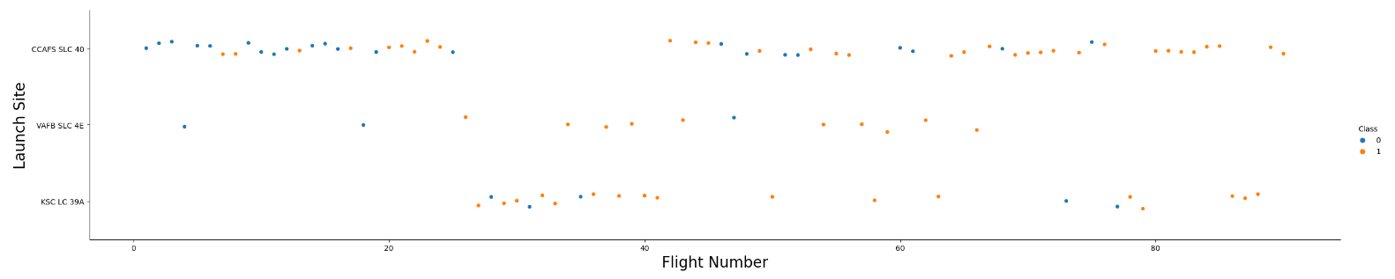
Flight Number vs. Launch Site
We can see for each Launch Site, with the progress of launches came more succesful landings
CCAFS SLC 40 brought a bunch of failures at the begining

Slide 17
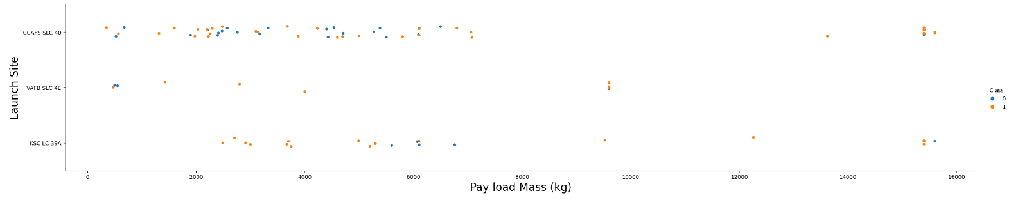
Payload vs. Launch Site
KSC LC 39A showed mostly succesful across the payload mass range, with exceptions around the 6000 kg
VAFB SLC 4E was mostly used in the lower ranges of payload mass
Overall, little tests above 8000 kg

Slide 18
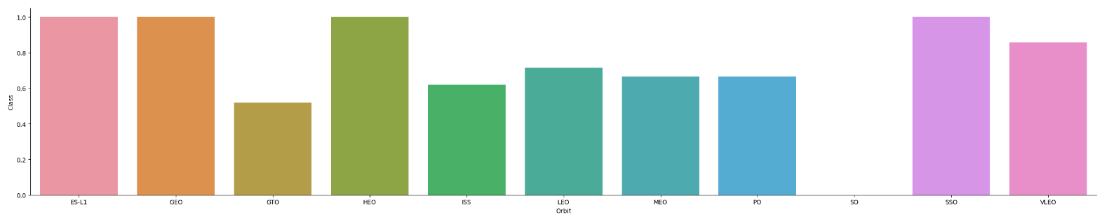
Success Rate vs. Orbit Type
We can see overall 3 ranges of succefulness rates: 4 orbits with rates around 1, 5 orbits around 0.6, and one orbit with 0 success

Slide 19
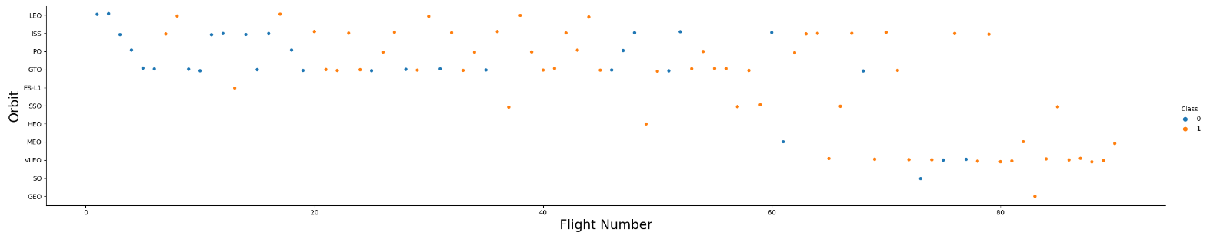
Flight Number vs. Orbit Type
Except for those orbit with little tests, we see the previous tendency of higher success rater toward latest launches

Slide 20
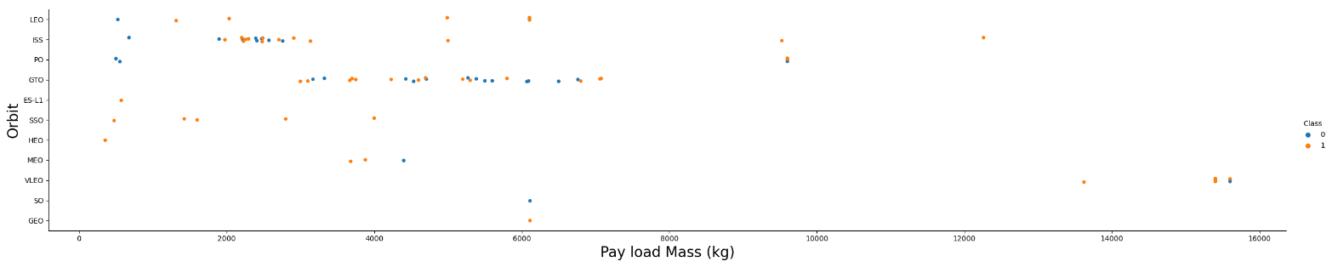
Payload vs. Orbit Type
For the first two orbits (LEO and ISS), see more successful landings towards higher payload mass
For the rest there is no clear tendency, we can say that at least this pair of variables can rarely give strong predictions

Slide 21
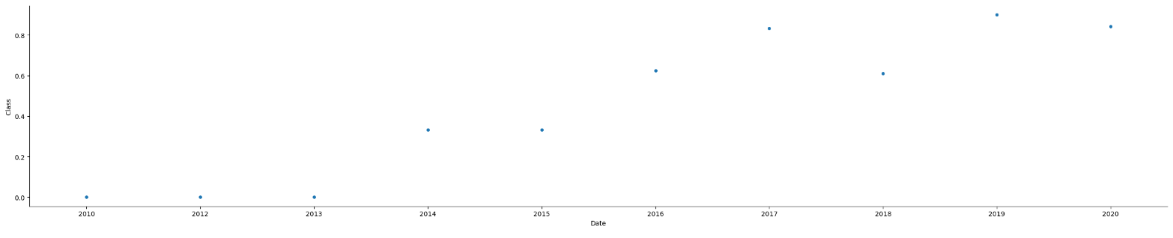
Launch Success Yearly Trend
The success rate first raised between 2013 and 2014
By year 2017-2020, the tendency stabilized around 0.8

Slide 22
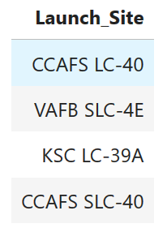
All Launch Site Names
These we the four launch sites used within the scope of the years 2010-2020
VAFB SLC-4E is located in US west coast
The other three in the US east cost
All of them, towards the south of the country, nearer the equator

Slide 23
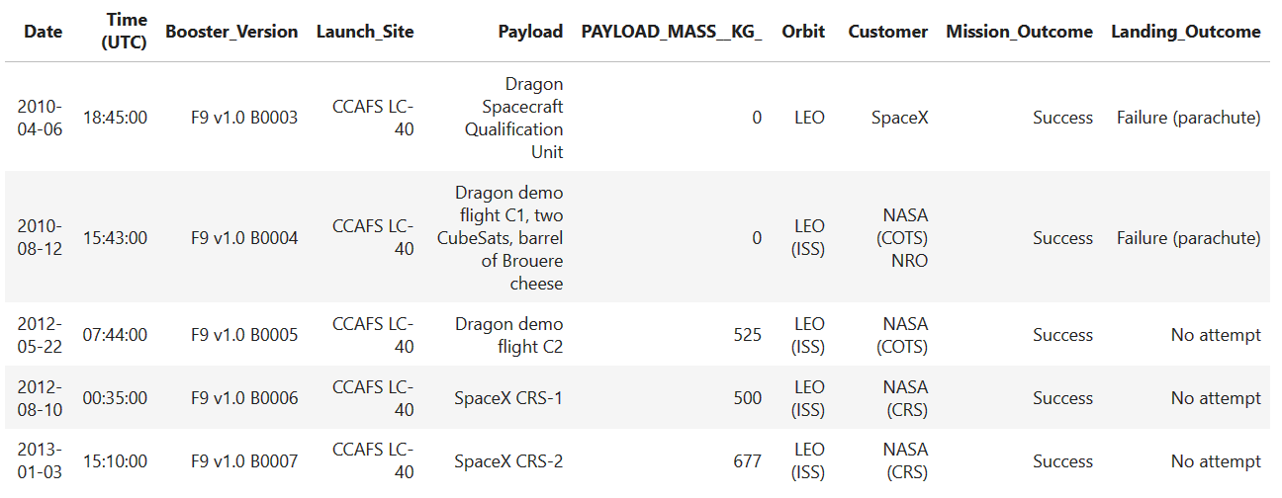
Launch Site Names Begin with 'CCA'
We can see the information available and the structure of the data

Slide 24
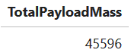
Total Payload Mass
Total payload carried by boosters from NASA
In kg
Calculated with SQL

Slide 25
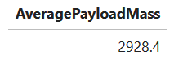
Average Payload Mass by F9 v1.1
Average payload mass carried by booster version F9 v1.1
In kg
Calculated with SQL

Slide 26
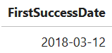
First Successful Ground Landing Date
Date of the first successful landing outcome on ground pad

Slide 27
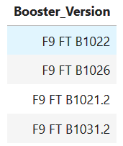
Successful Drone Ship Landing with Payload between 4000 and 6000
Names of boosters which have successfully landed on drone ship and had payload mass greater than 4000 but less than 6000 kg

Slide 28
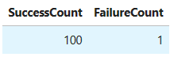
Total Number of Successful and Failure Mission Outcomes
Besides all the failed landings, most missions where considered successful taking into account the specific objectives SpaceX had for each mission

Slide 29
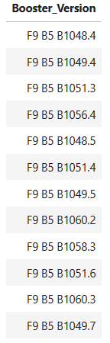
Boosters Carried Maximum Payload
List of names of the boosters which have carried the maximum payload mass

Slide 30
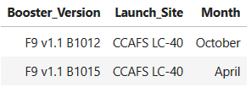
2015 Launch Records
List of failed landing_outcomes in drone ship in year 2015
We can see these were all launched from CCAFS LC-40
See appendix for SQL code

Slide 31
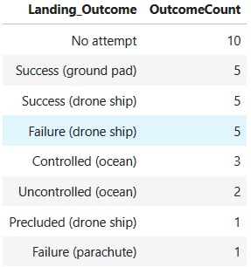
Rank Landing Outcomes Between 2010-06-04 and 2017-03-20
Rank of the count of landing outcomes in descending order
Within these dates we can see an approximate distribution of thirds (~33% each) between No attempts, Success and Failures

Slide 32

Section 3

Slide 33
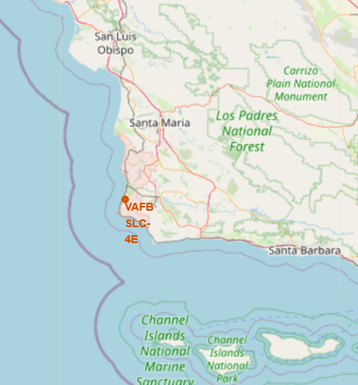
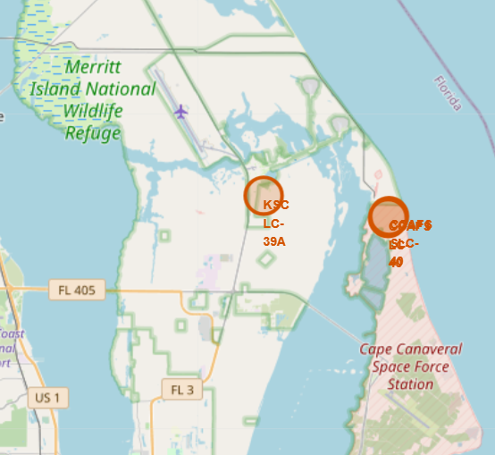
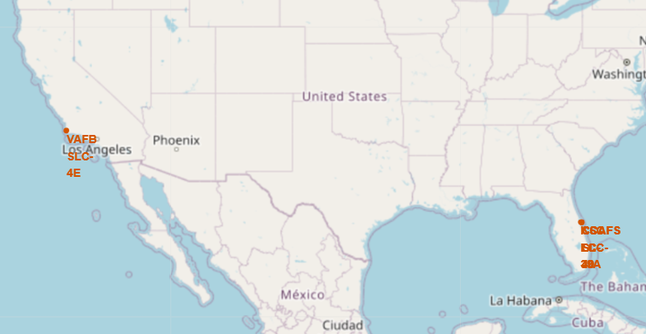
Launch Sites
We can see the launch sites are located towards the southernmost locations along the east and west coast, in order to be near the equator which benefits the launch physics

Slide 34
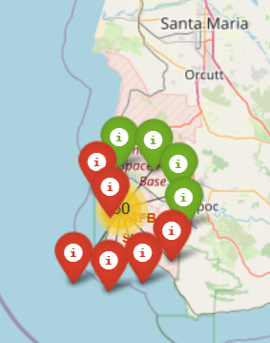
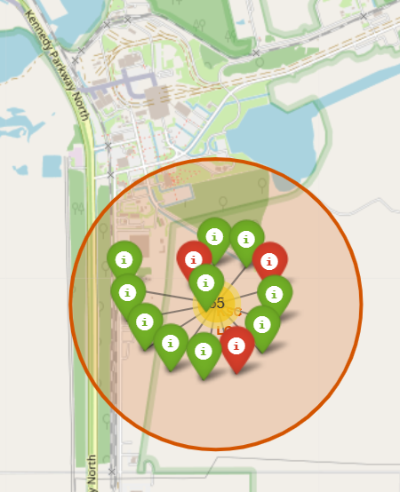
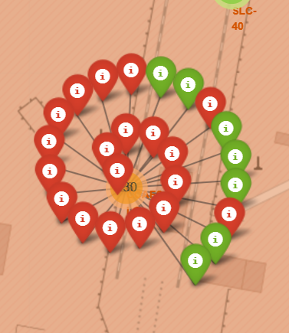
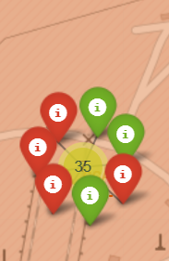
Landing outcomes
From left to right we have launch sites VAFB SLC-4E, KSC LC-39A, CCAFS LC-40, CCAFS SLC-40
In red color we have failed landings, in green successful landings
Most launches where attempted from east cost, probably due to be southernmost
KSC LC-39A has the highest success rate

Slide 35
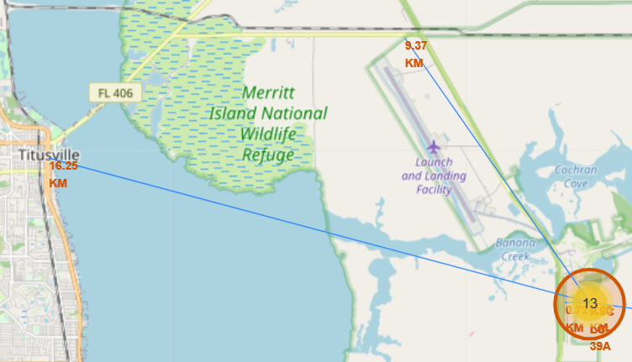
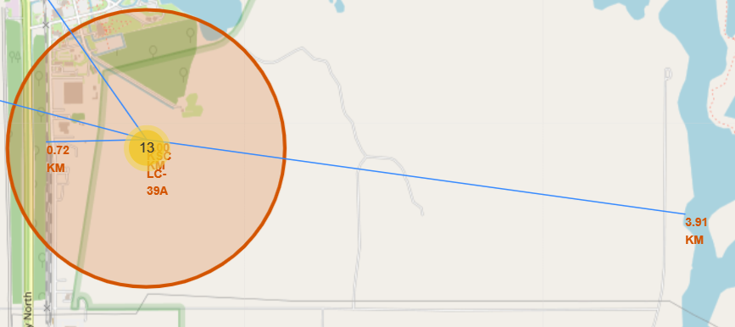
Locations close to KSC LC-39A
Launch site and its proximities to locations like closest railway, highway, coastline and city, with distance calculated and displayed
Most important information is the big distance to cities and close vicinity to east coastline
See appendix for code implemented

Slide 36

Section 4

Slide 37
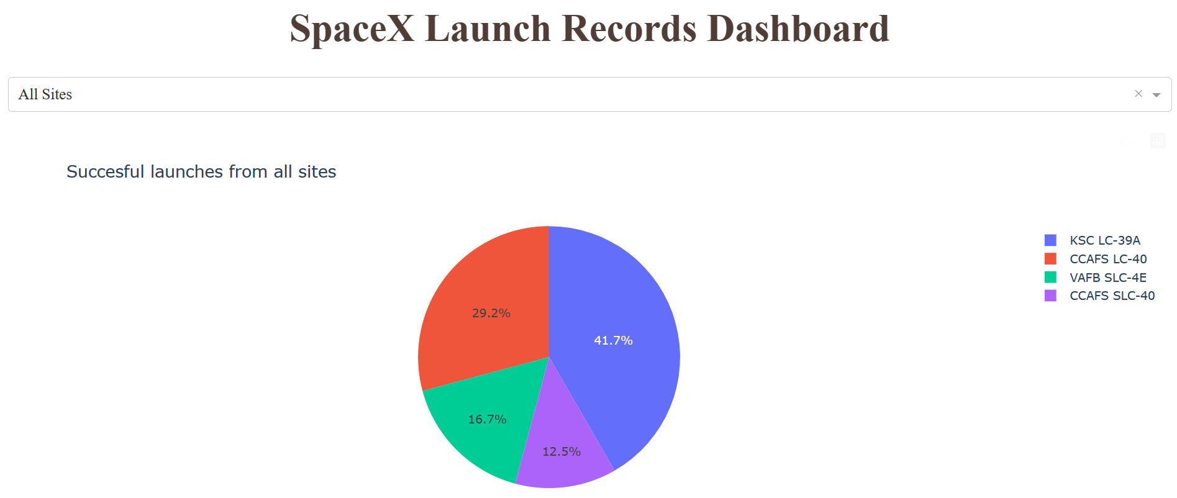
Landing success rates from all sites
We see KSC LC-39A has the highest landing success rate
CCAFS SLC-40 has the lowest rate, but as seen before, has also the least launches. Then we can say there is not enough data for statistical conclusions

Slide 38
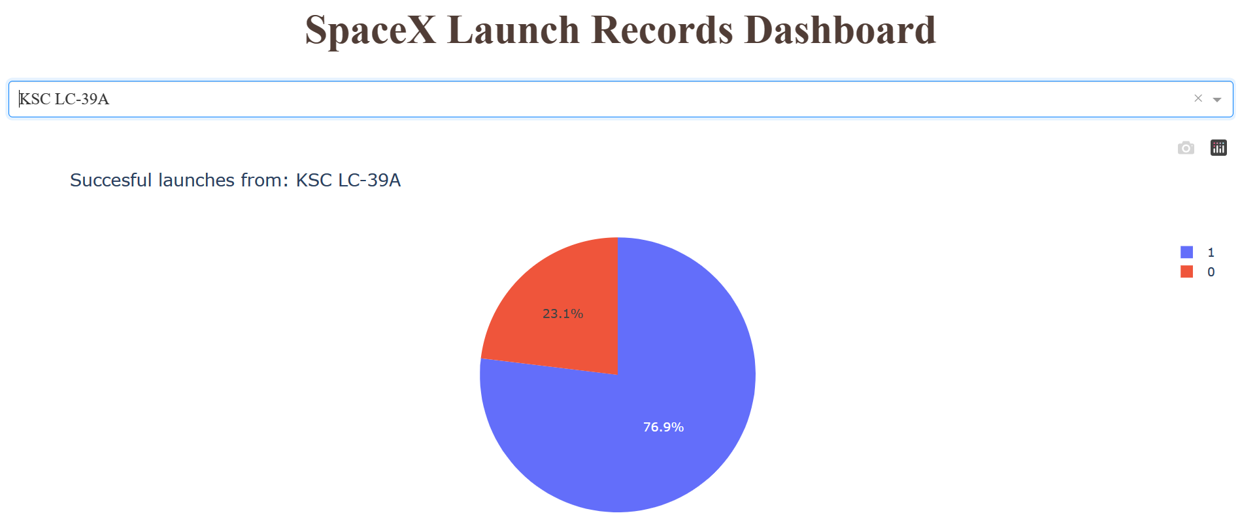
Launch site with highest landing success rate
KSC LC-39A not only has the highest landing success rate, but is also the only one with more than 50% success rate.

Slide 39
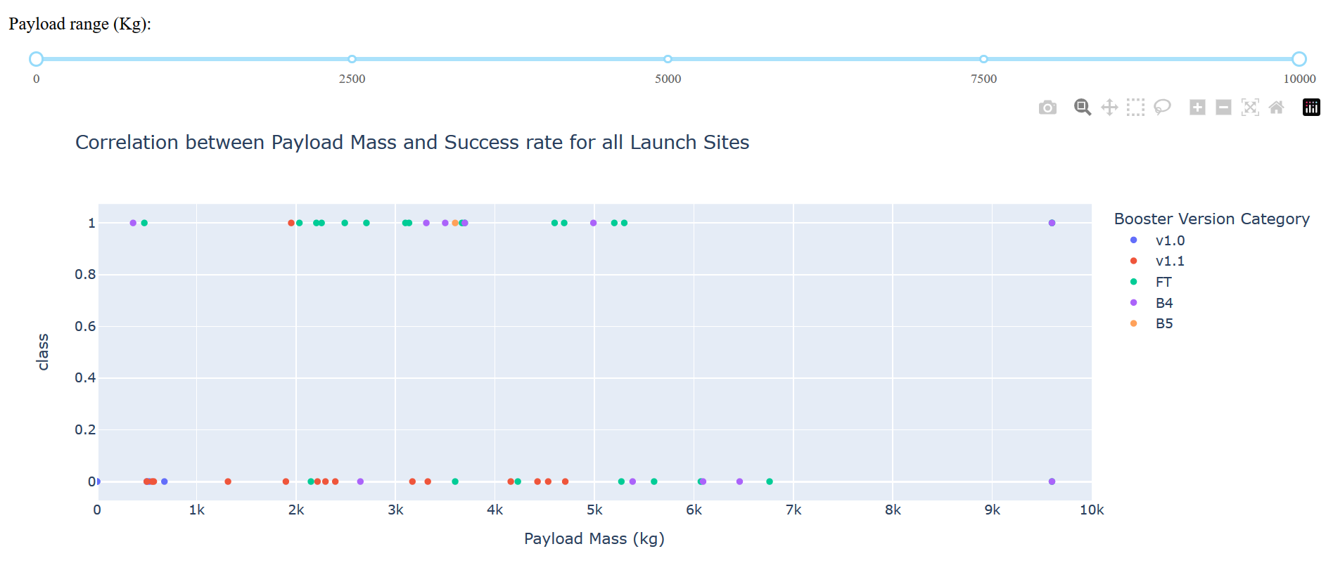
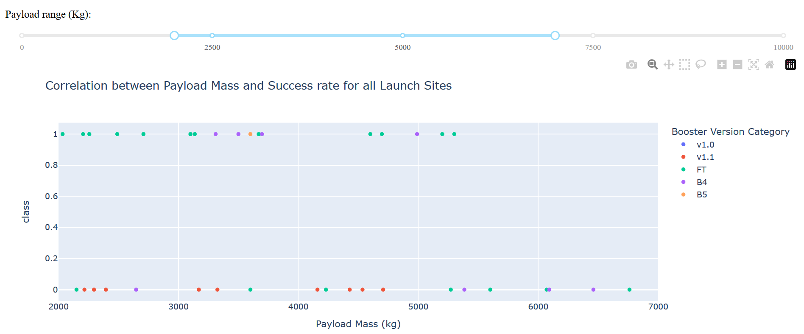
Landing success vs Payload mass
Top: 0-10K kg (full rage of payload mass)
Bottom: 2K-7K kg payload mass
For both, different color points for different Booster Version Category
We see booster “FT” was the most successful
Only one successful test was achieved above 5.5K kg, by booster “B4”

Slide 40

Section 5

Slide 41
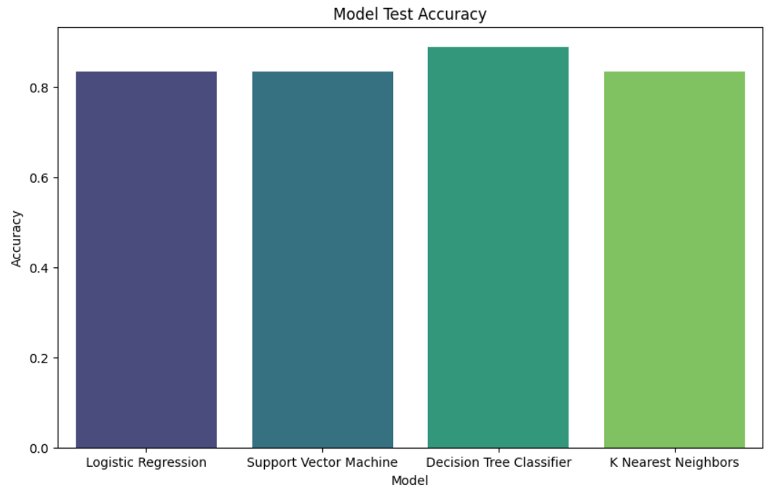
Classification Accuracy
The Decision Tree Classifier had the highest test accuracy with a score of 0.89
The other methods scored with 0.84

Slide 42

Confusion Matrix
We can see for the result “did not land”, the model made 5 correct predictions and 1 incorrect
For value “landed”, made 11 correct predictions against 1 incorrect

Slide 43
Conclusions
Success rates for SpaceX launches improved significantly between 2013 and 2017, reflecting enhancements in reliability and capabilities over time. This underscores SpaceX's ability to continuously refine its systems and processes.
Among launch sites, Kennedy Space Center LC-39A had the highest success rate at 75% over 13 launches during the 2010-2020 period analyzed. This highlights it as SpaceX's most reliable launch site.
The Falcon 9 Full Thrust booster proved to be SpaceX's most reliable rocket, with a 62% success rate on landing attempts. This demonstrates the engineering improvements made to later Falcon 9 versions.
Payload mass showed little correlation to landing success rates. This suggests success is driven by factors beyond just payload size, like launch site, booster version, avionics software, etc.
SpaceX's landing success rate plateaued around 80% by 2017, despite continued heavy use of droneship landings. This points to the maturing limits of reusable booster technology using current designs.
Southern launch locations like LC-39A and SLC-40 are critical for SpaceX to maximize payload capacity under the physics of rocket launches. Proximity to the equator provides velocity benefits.

Slide 44
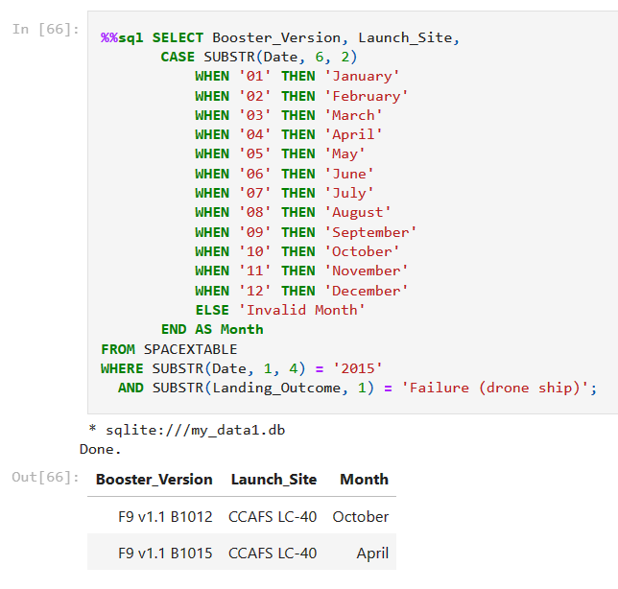
Appendix – Months for failed landings in 2015

Slide 45
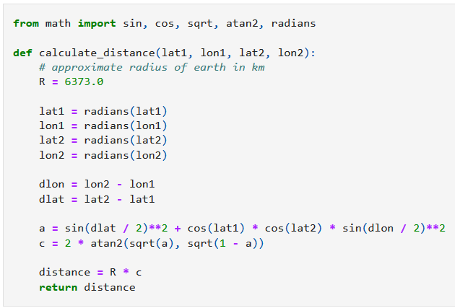
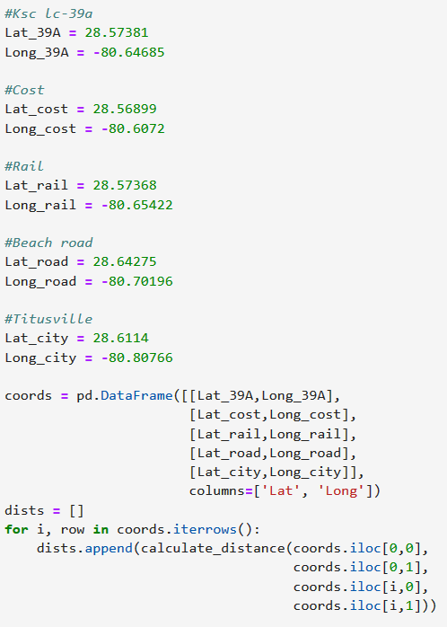
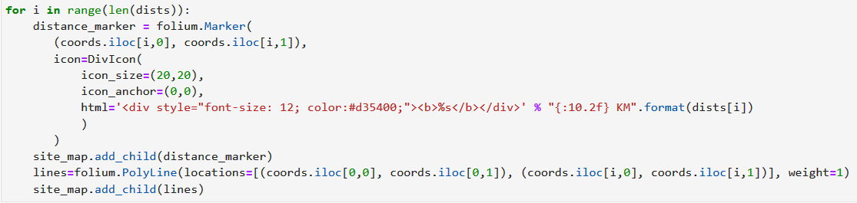
Appendix – Graphing PolyLine and distances
A
B
Outcome
See blue lines and distances in KM
C

Slide 46


